Slide 1
Chapter 5: Advanced SQL

Slide 2
Outline
Functions and Procedures
Triggers
Advanced Aggregation Features

Slide 3
Functions and Procedures

Slide 4
Functions and Procedures
Functions and procedures allow “business logic” to be stored in the database and executed from SQL statements.
These can be defined either by the procedural component of SQL or by an external programming language such as Java, C, or C++.
The syntax we present here is defined by the SQL standard.
  Most databases implement nonstandard versions of this syntax.

Slide 5
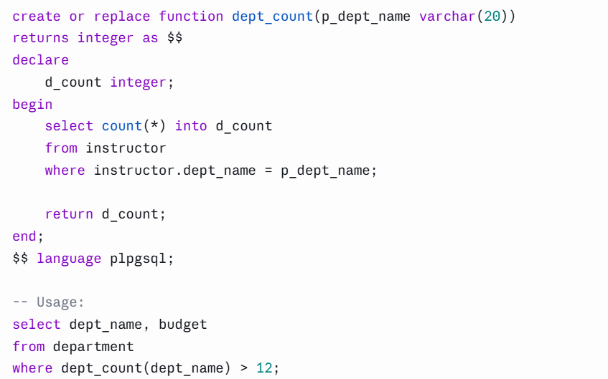
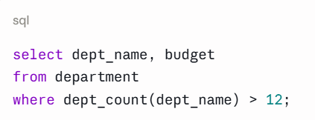
Declaring SQL Functions
Define a function that, given the name of a department, returns the count of the number of instructors in that department.
The function dept_count can be used to find the department names and budget of all departments with more that 12 instructors.

Slide 6
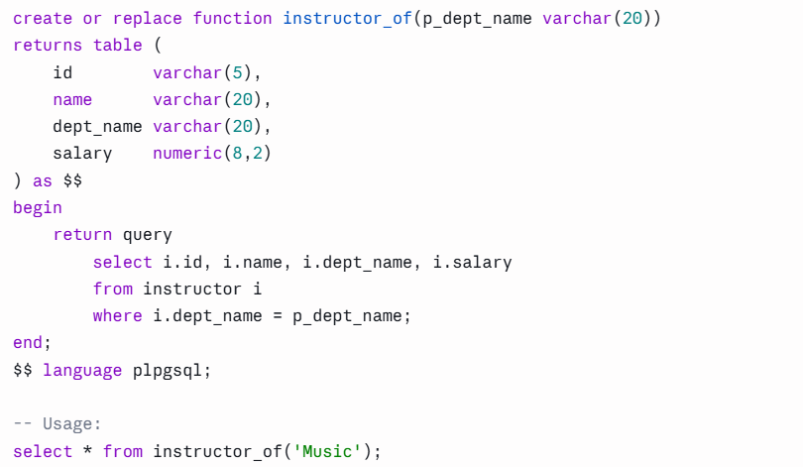
Table Functions
The SQL standard supports functions that can return tables as results; such functions are called table functions
Example: Return all instructors in a given department

Slide 7
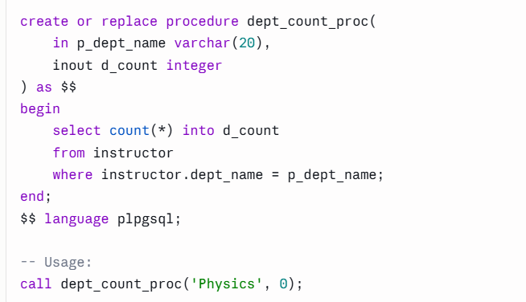
SQL Procedures
The dept_count function could instead be written as procedure:

Slide 8
Language Constructs for Procedures & Functions
SQL supports constructs that gives it almost all the power of a general-purpose programming language.
  Warning: most database systems implement their own variant of the standard syntax below.
Compound statement: begin … end,
  May contain multiple SQL statements between begin and end.
  Local variables can be declared within a compound statements
While and repeat statements:
  while boolean expression do
    sequence of statements ;
  end while
  repeat
    sequence of statements ;
  until boolean expression
  end repeat

Slide 9
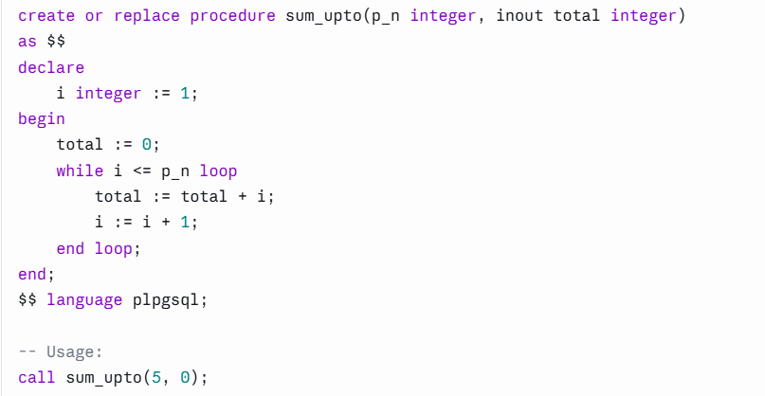
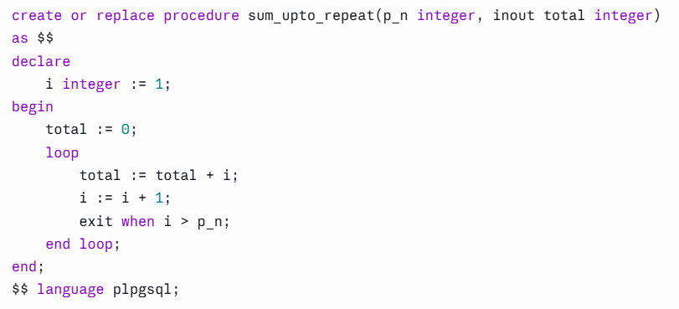
Examples

Slide 10
SQL/Persistent Stored Modules Standard
create procedure raise_all_salaries (in dept_name varchar(20), in percent numeric(4,2))
begin
declare done int default 0;
declare emp_id varchar(5);
declare curr_salary numeric(8,2);
declare emp_cursor cursor for
select ID, salary from instructor
where instructor.dept_name = raise_all_salaries.dept_name;
declare continue handler for not found set done = 1;
open emp_cursor;
fetch emp_cursor into emp_id, curr_salary;
while done = 0 do
update instructor set salary = curr_salary * (1 + percent/100)
where ID = emp_id;
fetch emp_cursor into emp_id, curr_salary;
end while;
close emp_cursor;
end

Slide 11
Example pgSQL
create or replace procedure raise_all_salaries_while(p_dept_name varchar(20), p_percent numeric(4,2))
as $$
declare
emp_id varchar(5);
curr_salary numeric(8,2);
emp_cursor cursor for
select id, salary from instructor
where instructor.dept_name = p_dept_name;
v_found boolean := true;
begin
open emp_cursor;
fetch emp_cursor into emp_id, curr_salary;
v_found := found;
while v_found loop
update instructor
set salary = curr_salary * (1 + p_percent / 100)
where id = emp_id;
fetch emp_cursor into emp_id, curr_salary;
v_found := found;
end loop;
close emp_cursor;
end;
$$ language plpgsql;

Slide 12
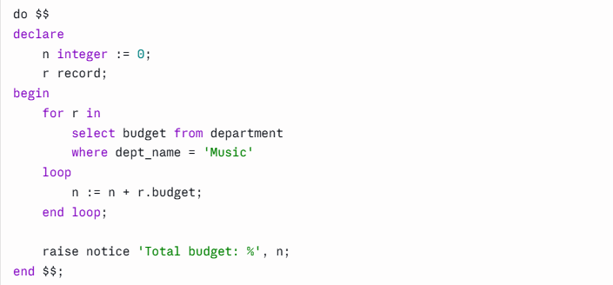
Language Constructs (Cont.)
For loop
  Permits iteration over all results of a query
Example: Find the budget of Music departments

Slide 13
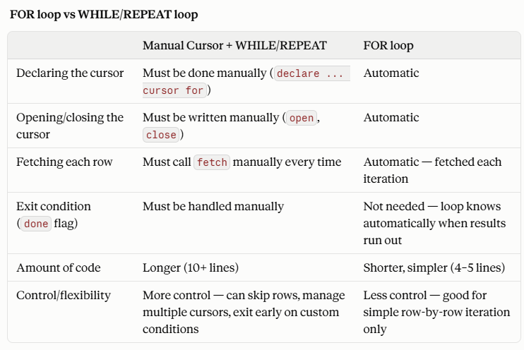
For and While/Repeat Difference

Slide 14
Same Example
create or replace procedure raise_all_salaries(p_dept_name varchar(20), p_percent numeric(4,2))
as $$
declare
r record;
begin
for r in
select id from instructor
where instructor.dept_name = p_dept_name
loop
update instructor
set salary = salary * (1 + p_percent / 100)
where id = r.id;
end loop;
end;
$$ language plpgsql;

Slide 15
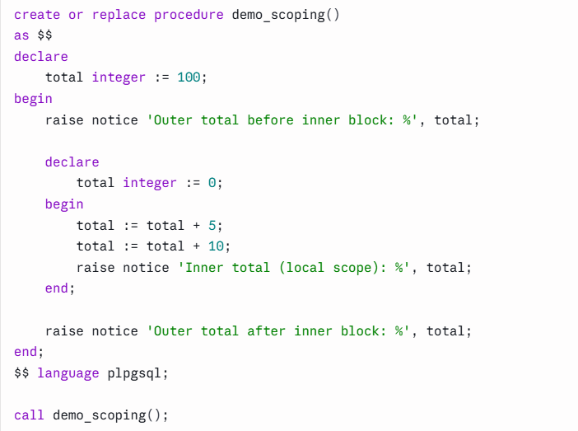
Example

Slide 16
Language Constructs – if-then-else
Conditional statements (if-then-else)
if boolean expression
then statement or compound statement
elseif boolean expression
then statement or compound statement
else statement or compound statement
end if

Slide 17
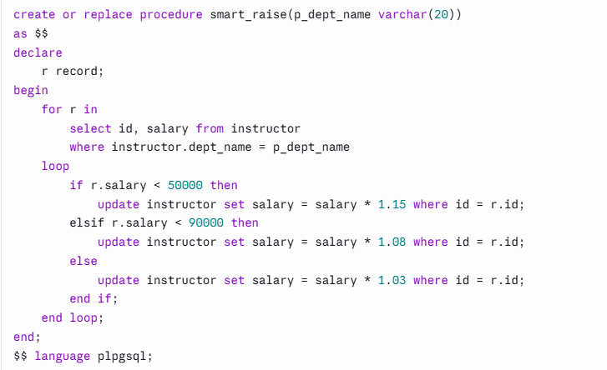
Example

Slide 18
Triggers

Slide 19
Triggers
A trigger is a statement that is executed automatically by the system as a side effect of a modification to the database.
To design a trigger mechanism, we must:
  Specify the conditions under which the trigger is to be executed.
  Specify the actions to be taken when the trigger executes.
Triggers introduced to SQL standard in SQL:1999, but supported even earlier using non-standard syntax by most databases.
  Syntax illustrated here may not work exactly on your database system; check the system manuals

Slide 20
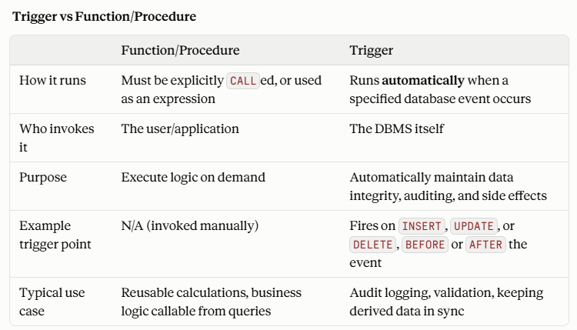
Triggers and Procedure/Function Difference

Slide 21
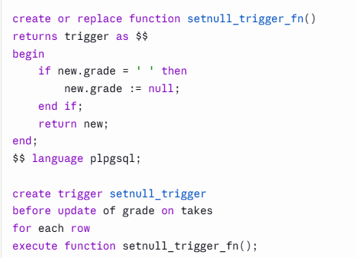
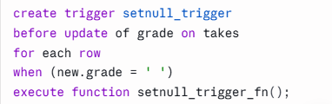
Triggering Events and Actions in SQL
Triggering event can be insert, delete or update
Triggers on update can be restricted to specific attributes
  For example, after update of takes on grade
Values of attributes before and after an update can be referenced
  referencing old row as : for deletes and updates
  referencing new row as : for inserts and updates
Triggers can be activated before an event, which can serve as extra constraints. For example, convert blank grades to null.

Slide 22
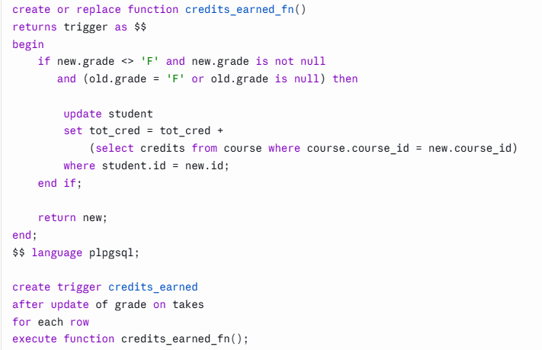
Trigger to Maintain credits_earned value
Two key differences between Assertion and Trigger:
Scope of checking — An assertion re-evaluates its condition across the entire relevant data every time something changes; a trigger only acts on the specific row/event that changed.
Behavior — An assertion passively checks and rejects the operation if the condition is violated; a trigger actively performs an action (like updating a value) in response to the event — it doesn't just check, it fixes/maintains data automatically.

Slide 23
Statement Level Triggers
Instead of executing a separate action for each affected row, a single action can be executed for all rows affected by a transaction
  Use for each statement instead of for each row
  Use referencing old table or referencing new table to refer to temporary tables (called transition tables) containing the affected rows
  Can be more efficient when dealing with SQL statements that update a large number of rows

Slide 24
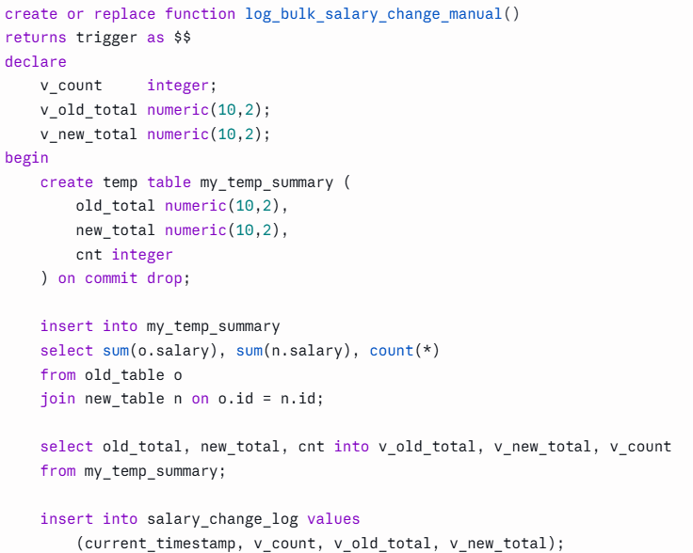
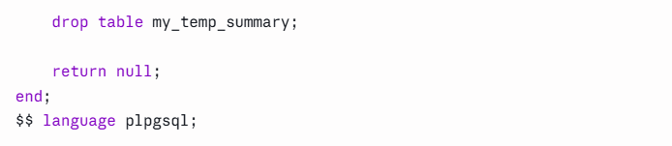
Statement Level Triggers

Slide 25
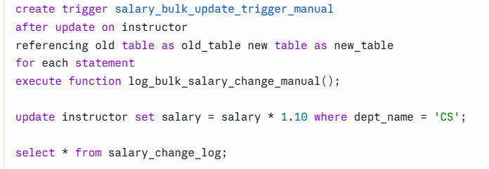
Statement Level Triggers (cont’)

Slide 26
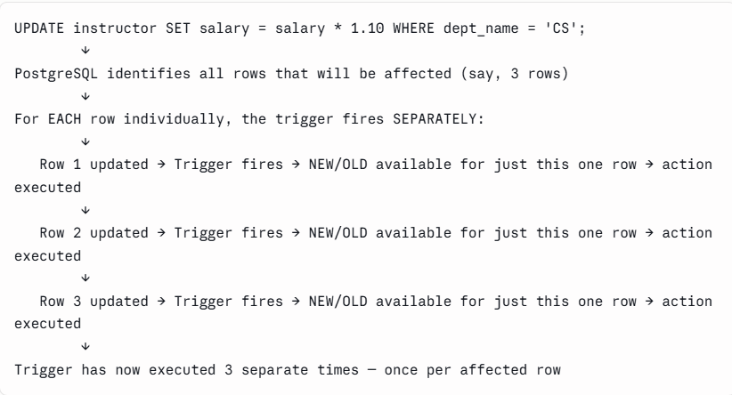
Flow Summary — Row-Level Trigger

Slide 27
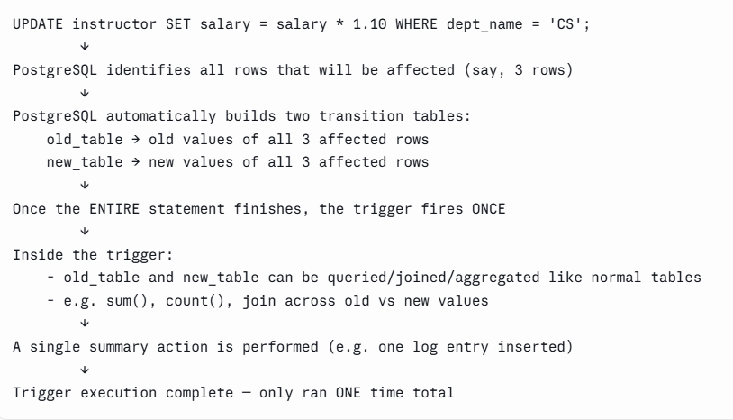
Flow Summary — Statement-Level Trigger (with Transition Tables)

Slide 28
Advanced Aggregation Features

Slide 29
Ranking
Ranking is done in conjunction with an order by specification.
Suppose we are given a relation
student_grades(ID, GPA)
giving the grade-point average of each student
Find the rank of each student.
select ID, rank() over (order by GPA desc) as s_rank
from student_grades
An extra order by clause is needed to get them in sorted order
select ID, rank() over (order by GPA desc) as s_rank
from student_grades
order by s_rank
Ranking may leave gaps: e.g. if 2 students have the same top GPA, both have rank 1, and the next rank is 3
  dense_rank does not leave gaps, so next dense rank would be 2
Notes:
29

Slide 30
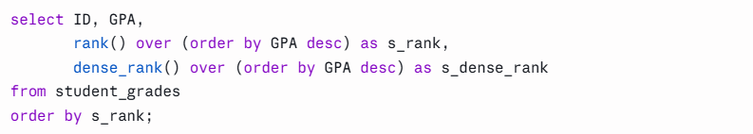
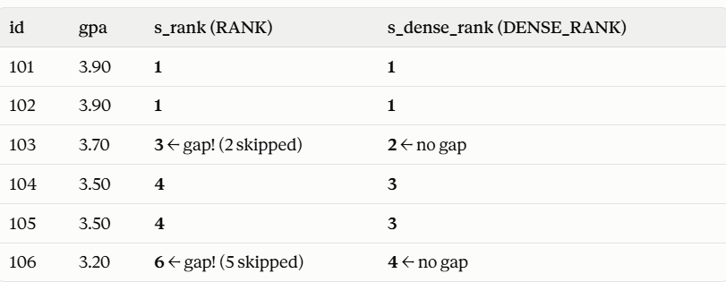
Rank() vs. Dense_Rank()

Slide 31
Ranking
Ranking can be done using basic SQL aggregation, but resultant query is very inefficient
  select ID, (1 + (select count(*)
  from student_grades B
  where B.GPA > A.GPA)) as s_rank
  from student_grades A
  order by s_rank;

Slide 32
Ranking (Cont.)
Ranking can be done within partition of the data.
“Find the rank of students within each department.”
select ID, dept_name,
rank () over (partition by dept_name order by GPA desc)
as dept_rank
from dept_grades
order by dept_name, dept_rank;
Multiple rank clauses can occur in a single select clause.
Ranking is done after applying group by clause/aggregation
Can be used to find top-n results
  More general than the limit n clause supported by many databases, since it allows top-n within each partition

Slide 33
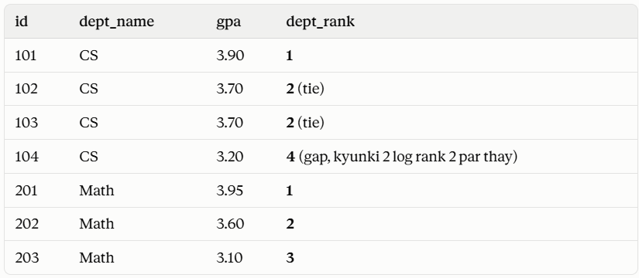
Example

Slide 34
OLAP

Slide 35
Data Analysis and OLAP
Online Analytical Processing (OLAP)
  Interactive analysis of data, allowing data to be summarized and viewed in different ways in an online fashion (with negligible delay)
Data that can be modeled as dimension attributes and measure attributes are called multidimensional data.
  Measure attributes
    measure some value
    can be aggregated upon
    e.g., the attribute number of the sales relation
  Dimension attributes
    define the dimensions on which measure attributes (or aggregates thereof) are viewed
    e.g., attributes item_name, color, and size of the sales relation

Slide 36
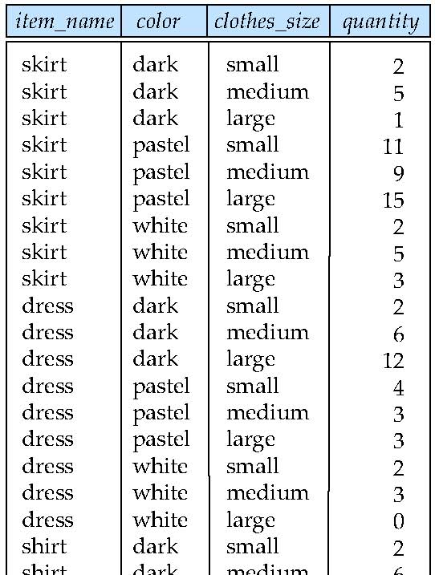
Example sales relation
...
...
...
...
...
...
...
...

Slide 37
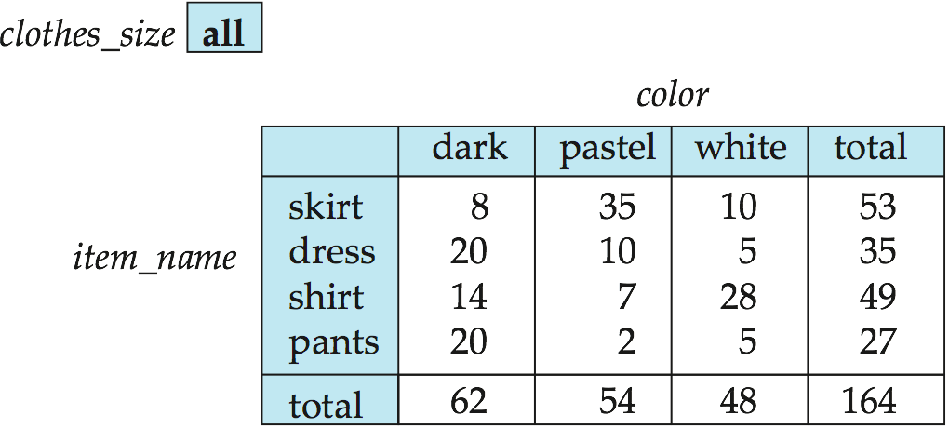
Cross Tabulation of sales by item_name and color
The table above is an example of a cross-tabulation (cross-tab), also referred to as a pivot-table.
  Values for one of the dimension attributes form the row headers
  Values for another dimension attribute form the column headers
  Other dimension attributes are listed on top
  Values in individual cells are (aggregates of) the values of the
  dimension attributes that specify the cell.

Slide 38
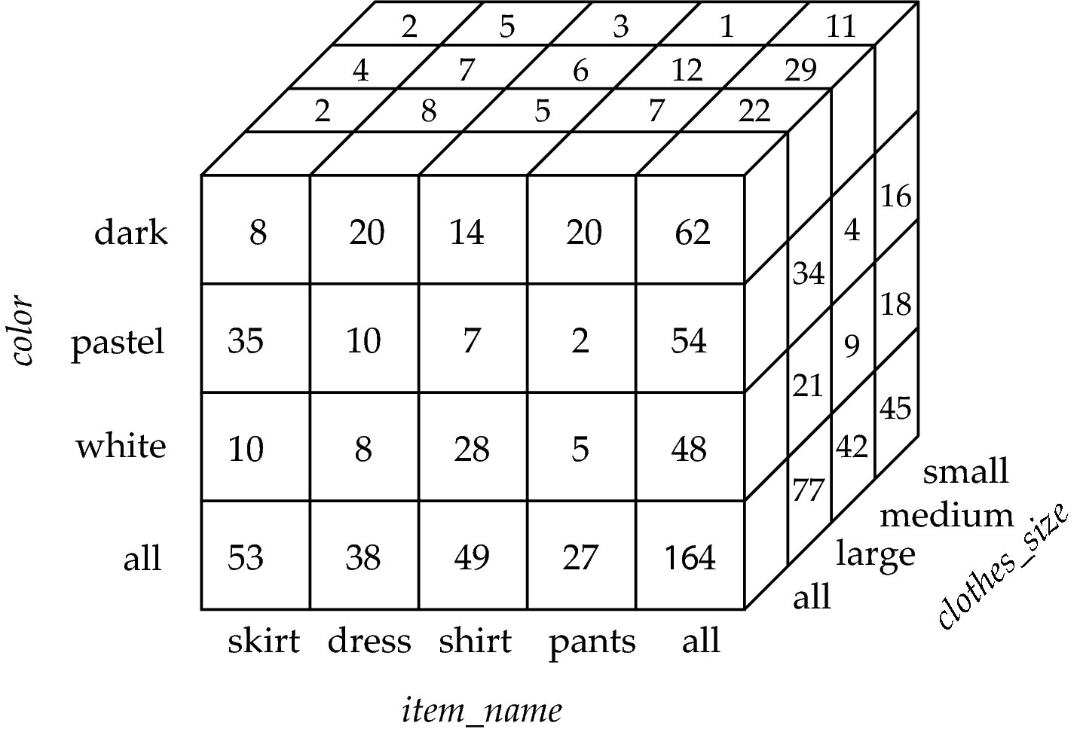
Data Cube
A data cube is a multidimensional generalization of a cross-tab
Can have n dimensions; we show 3 below
Cross-tabs can be used as views on a data cube

Slide 39
End of Chapter 5

